Slide 1
Adaptive Designs for Confirmatory Clinical Trials
Cyrus R. Mehta
President, Cytel Inc.
Brigham and Women’s Hospital
Department of Rheumatology

Slide 2
What are Flexible Clinical Trials?
Traditional Design: fix the sample size in advance and only perform one efficacy analysis after all subjects have been enrolled and evaluated.
Flexible Design: monitor the accruing efficacy data at administratively convenient intervals and make important decisions concerning the future course of the study along the way.

Slide 3
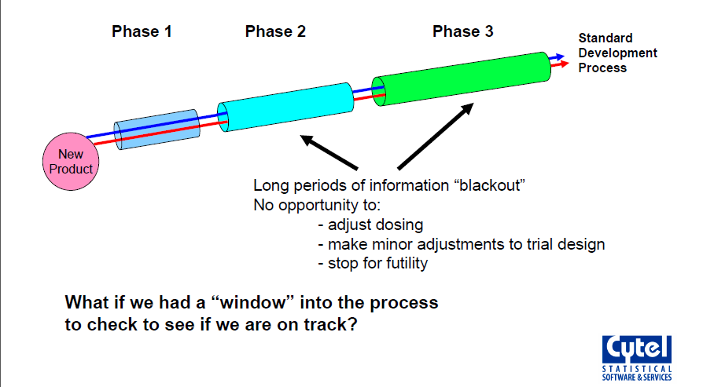
Traditional Clinical Development Process

Slide 4
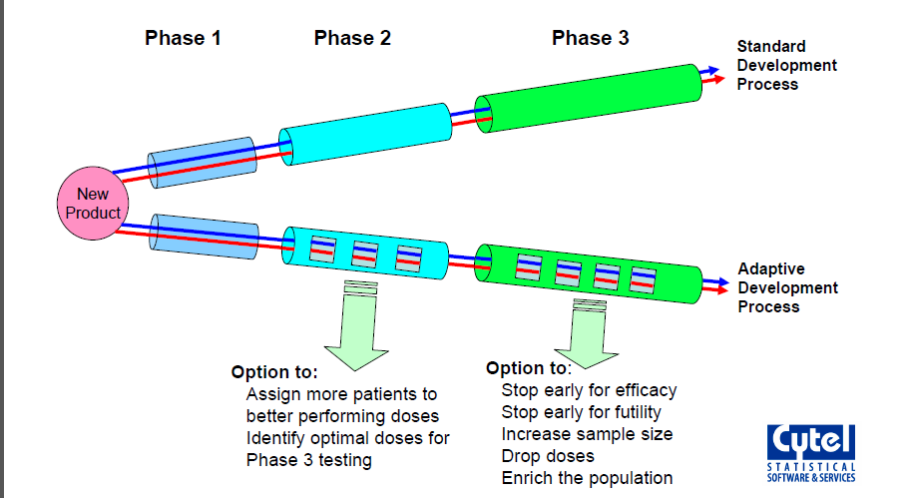
Adaptive Clinical Development Process

Slide 5
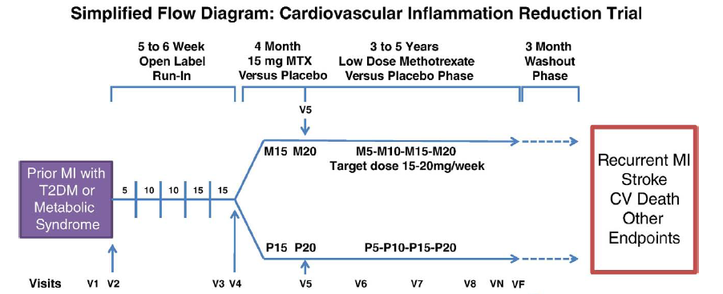
Example 1: The CIRT Trial
Patients with type-2 diabetes treated with methotrexate or matching placebo (AHJ, 2013)

Slide 6
Event Driven Trial to Detect HR=0.75
Enroll 7000 patients over 4 years; and follow for 1 more year until 530 CV events obtained
Given 3.25% events/year on placebo, trial has:
91% power to detect HR=0.75 (25% risk reduction)
73% power to detect HR=0.8 (20% risk reduction)
How can we recover lost power if HR=0.8?

Slide 7
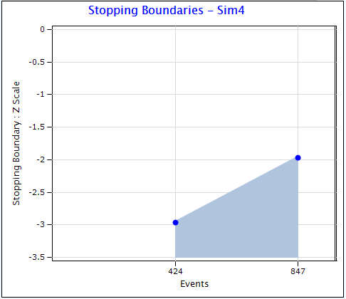
Option 1: Large Group Sequential Trial
11,000 patients and 847 events over 5 years provides 91% power to detect HR=0.8
Group sequential boundary for early stopping
Early stopping probability:
27% if HR=0.8
50% if HR=0.75
Problem: Only 1.5 years of average follow-up if early stop

Slide 8
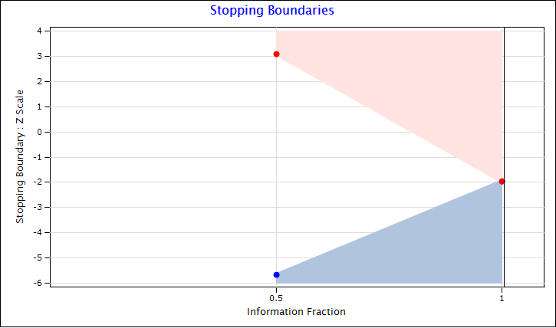
Option 2: Promising Zone Design
Start small: 7000 patients and 530 events
Increase by 50% if interim results are promising
Promising zone is defined by conditional power
Unfavorable:
CP<50%
Promising: 50%≤CP<90%
Favorable:
CP>90%
Unfavorable Zone
Promising Zone
Favorable Zone

Slide 9
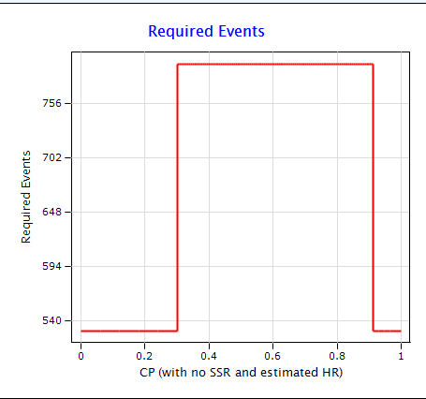
Sample Size Increase Decision Rule

Slide 10
Design Optimistically: Assume HR=0.75
Operating Characteristics if in Truth Risk Reduction is 20% (HR=0.8)
Zone | P(Zone) | Power |  | Sample Size |  | Study Duration
 |  | NonAdapt | Adaptive | NonAdapt | Adaptive | NonAdapt | Adaptive
Unfav | 24% | 38% | 38% | 7000 | 7000 | 4.9 | 4.9
Prom | 36% | 74% | 90% | 7000 | 10500 | 4.9 | 5.7
Fav | 40% | 95% | 95% | 7000 | 7000 | 4.9 | 4.9
Operating Characteristics if in Truth Risk Reduction is 25% (HR=0.75)
Zone | P(Zone) | Power |  | Sample Size |  | Study Duration
 |  | NonAdapt | Adaptive | NonAdapt | Adaptive | NonAdapt | Adaptive
Unfav | 12% | 57% | 57% | 7000 | 7000 | 5 | 5
Prom | 28% | 87% | 98% | 7000 | 10500 | 5 | 5.8
Fav | 60% | 99% | 99% | 7000 | 7000 | 5 | 5

Slide 11
Example 2: The EXAMINE Trial
Multicenter randomized double blind placebo controlled study of Alogliptin a DPP4 inhibitor
Designed to rule out excess risk of CV outcomes in very high risk T2DM patients
Primary Endpoint: composite of first occurrence of CV death, MI or stroke (MACE)
FDA Guidance: estimate upper bound of 95% RCI for the hazard ratio of Alogliptin/Placebo
if < 1.8: submit pre-marketing NDA for alogliptin
if < 1.3: CV safety demonstrated

Slide 12
EXAMINE: Group Sequential Design
1.8
1.3
1
80
100
125
150
O’Brien-Fleming spending function
Sample size: 5400
Events: 150 for 1.8 and 650 for 1.3
Enrolment 2 years
Trial duration 4.25 years
94% power for 1.8 for true HR=1
91% power for 1.3 for true HR=1
Only 53% power to claim superiority if true HR=0.85
550
650
550
650

Slide 13
EXAMINE: Study Results
83
100
125
150
Total enroll: 5383
IA1: 83 events
Upper bound of RCI: 1.51
Submitted NDA
IA2: 550 events
HR: 0.96
Upper bound RCI: 1.17
Stopped to claim non-inferiority
White et. al. published in NEJM
Non-inferiority HR 1.8
Non-inferiority HR 1.3
Superiority HR 1
550
650
550
650
Trial could have continued to 650 events in hopes of showing superiority
Why stop at 550 and accept a non-inferiority claim?

Slide 14
Trial was underpowered for Superiority
Sample size requirements for a trial powered to show superiority
(assumes 2 years accrual and 3 additional years of follow-up)
Hazard Ratio | 80% Power |  | 90% Power
 | Events | Sample Size | Events | Sample Size
0.8 | 631 | 5253 | 845 | 7034
0.85 | 1189 | 9644 | 1592 | 12913
0.9 | 2829 | 22377 | 3787 | 29954
0.95 | 11933 | 92116 | 15975 | 123317
Deterrents to an up-front superiority design
Don’t know what HR to target
HR = 0.8 unlikely
HR > 0.85 leads to very large trial with high risk of failure

Slide 15
Less risky to allow switching from NI to Superiority objective at interim analysis
Power for non-inferiority with 650 events and 5400 patients
At interim analysis (IA-550), re-power for superiority by increasing the number of events and sample size provided:
NI criterion is met (RCI bound < 1.3)
CP(Sup) is in a “promising zone”

Slide 16
Decision Rules at Interim Analysis
IA at 550 events
NI criterion met (RCI <1.3)
NI criterion not met
Compute CP(Sup)
CP(Sup) < 20%
CP(Sup) ≥20%
Final Analysis at 650
Test for NI and Sup
Terminate and claim NI
Switch to Adaptive Design

Slide 17
The Path to an Adaptive Switch
IA at 550 events
NI criterion met (RCI <1.3)
NI criterion not met
Compute CP(Sup)
CP(Sup) < 20%
CP(Sup) ≥20%
Final Analysis at 650
Test for NI and Sup
Terminate and claim NI
Switch to Adaptive Design

Slide 18
Criteria for adaptive increase of events and sample size
Switch to Adaptive Design
Unfavorable Zone
20%<CP(Sup)<50%
Promising Zone
50%≤CP(Sup)<90%
Go to 650 events
Increase events to 1300
Incr sample size to 10,800
Go to 650 events

Slide 19
Results: If IA-550 is in Promising Zone

Slide 20
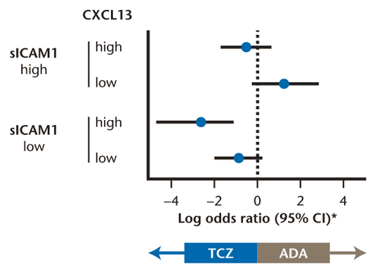
Example 3: The ADACTA Trial
Tocilizumab is superior to adalimumab for methotrexate-intolerant RA patients
Mean drop in DAS28: 3.3 vs 1.8 (p<0.0001)
Subgroup analysis suggested that the sICAM1 is a predictive biomarker for tocilizumab (ACR70 endpoint)

Slide 21
Possible Follow-up to ADACTA Tria
Consider a trial of TCZ vs ADA in RA patients on concurrent methotrexate
Binary endpoint: ACR70 response at 6 months
Design Assumptions:
30% response rate for TCZ versus 20% for ADA
It is plausible that treatment effect (TCZ minus ADA) is greater in sICAM-low than in sICAM-high
Create an adaptive enrichment design to protect against power loss if sICAM is a predictive biomarker

Slide 22
Trial Design Schema
TCZ
Favorable (CP≥90%)
Complete Trial as Planned
All Comers
Interim Analysis
Promising (30≤CP<90%)
Complete Trial with SSR
ADA
Unfavorable (CP<30%)
Consider Enrichment with sICAM-low

Slide 23
Prospectively Defined Enrichment Strategy
Favorable
(CP≥90%)
Enroll only sICAM-low and Complete the Trial
Compute CP for sICAM-low
Promising
(30%≤CP<90%)
Enroll only sICAM-low, Complete Trial with SSR
Unfavorable
(CP<30%)
Enroll All Comers and Complete the Trial

Slide 24
Operating Characteristics of Design
Enroll 300/arm with half being sICAM-low
If adaptive is invoked, increase sample size up to 900 to recover 90% conditional power
TCZ Response Rate |  | Power Gain of Adaptive |  | Cost of Adaptive Design
sICAM-low | sICAM-high | Conventional | Adaptive | Sample Size | Prob(enrich)
0.3 | 0.3 | 81% | 86% | 683 | 0.035
0.325 | 0.275 | 81% | 88% | 689 | 0.057
0.35 | 0.225 | 71% | 84% | 711 | 0.132
0.35 | 0.2 | 59% | 77% | 725 | 0.196
Response rate for ADA=0.2

Slide 25
Statistical Issues with Adaptive Designs
For a regulatory filing, must maintain strong control of type-1 error
Two sources of error inflation in these examples
due to unblinded sample size re-estimation
due to enrichment by subgroup selection
Handle the SSR by combining independent p-values for the two stages with pre-specified weights
Handle the subgroup selection by a closed test

Slide 26
Combining p-values with pre-specified weights
Let p₁ be the p-value from the first stage
Let p₂ be the independent p-value from the second stage
Note:
Special methods are needed to ensure independence of p₂ for censored survival data
W₁ and w₂ must be pre-specified such that (w₁)²+(w₂)²=1. Here we use

Slide 27
Closed Testing Procedure
H_{F}=null hypothesis (TCZ=ADA) for full population
H_{S}=null hypothesis (TCZ=ADA) for sICAM-low subgroup
Multiplicity problem arises because we are asking two questions; about H_{F} and H_{S}
Closed testing requires that we reject H_{F} or H_{S} and H_{S} H_{F} with valid level-alpha tests

Slide 28
Operational and Bias Issues
All design details are included in DMC charter
DMC buys into design at the kick-off meeting, but reserves right to exercise clinical judgment
Although the trial is expanded only if the IA shows promise of superiority:
Actual interim decision should only be conveyed on need to know basis (to drug supply and IVRS teams)
Investigators may be told only that this adaptive design has a maximum sample size of xxx patients and possibility of re-powering at IA
Use a double blind design if possible to avoid operational bias

Slide 29
Regulatory Issues
Many adaptive designs are complex. Engage the agencies in discussions early in the design stage
Explain why conventional design is not suitable
Submit an analytical proof that type-1 error is preserved despite the data dependent change to the design (Simulations are generally not acceptable due to complexity of the null space)
Submit simulations containing the operating characteristics of the design (power, average sample size, study duration, etc.)

Slide 30
Concluding Remarks
Adaptive designs preserve power through:
sample size re-estimation
subgroup selection
dose selection (for multi-arm trials)
Good compromise between running a very large, possibly over-powered, study and a small, possibly under-powered, study
Careful up-front planning and simulation to evaluate adaptive decision rules is essential

Slide 31
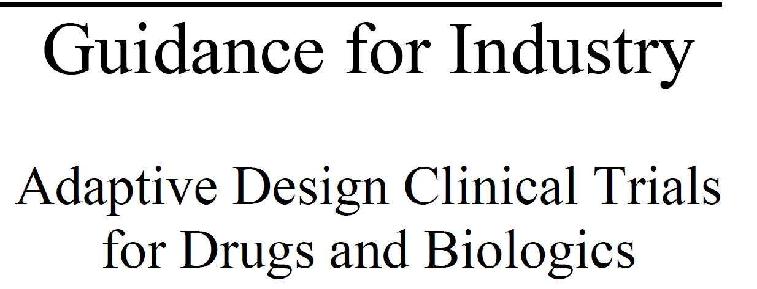
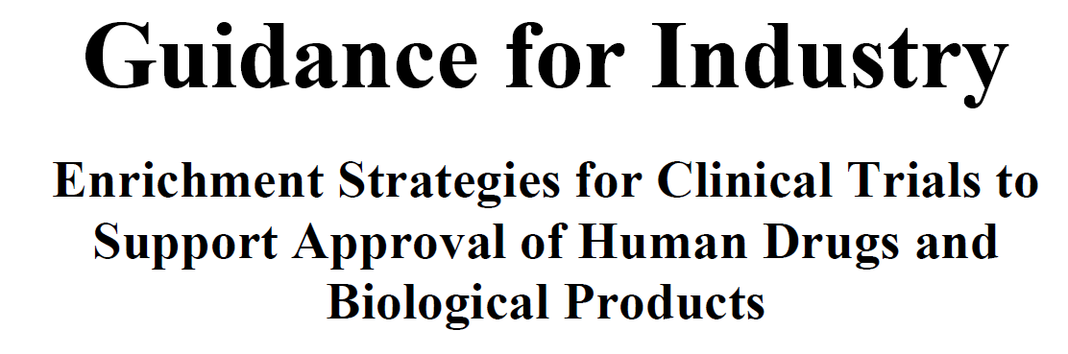
FDA Guidances on Adaptive Design
Issued in 2010
Issued in 2012

